Slide 1
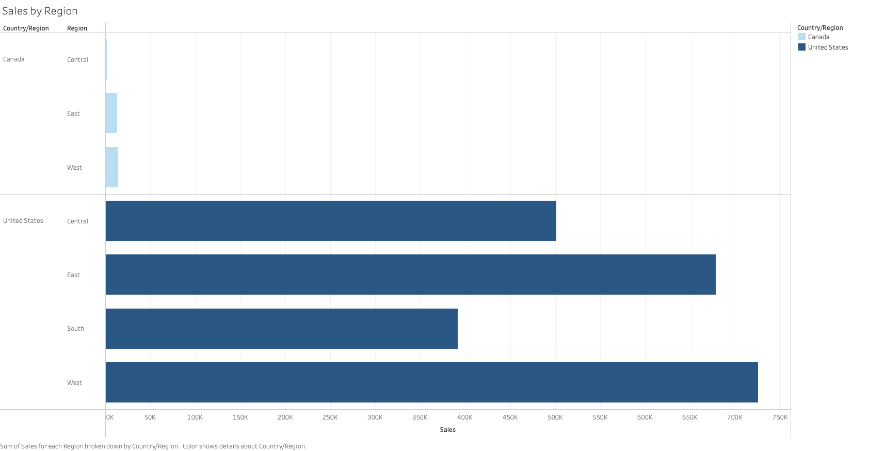
Sales By Region

Slide 2
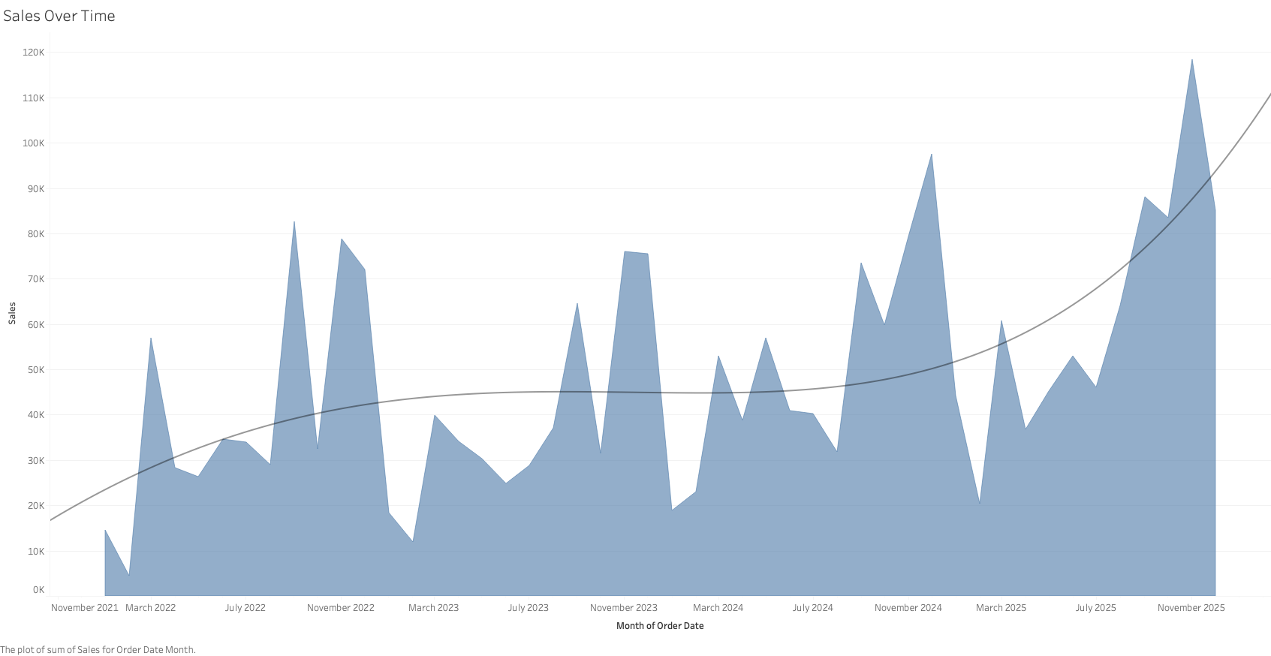
Sales Over Time

Slide 3
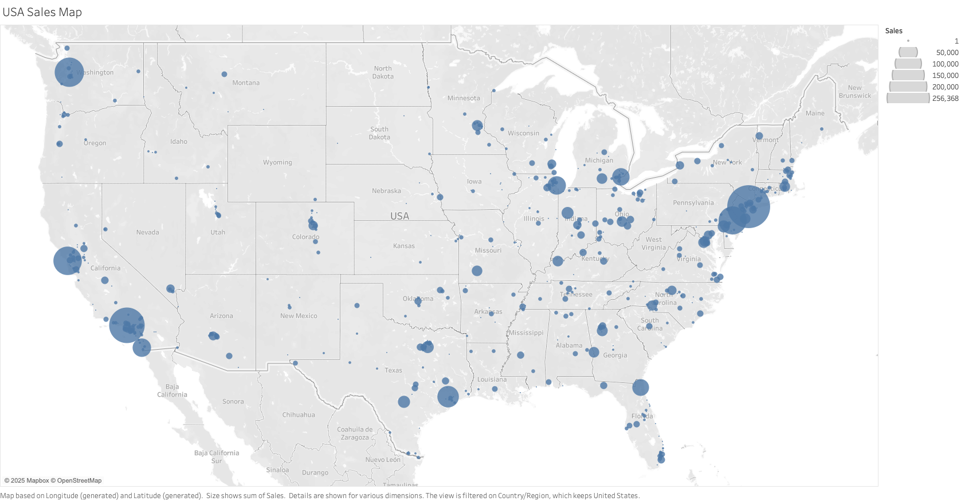
Usa Sales Map

Slide 4
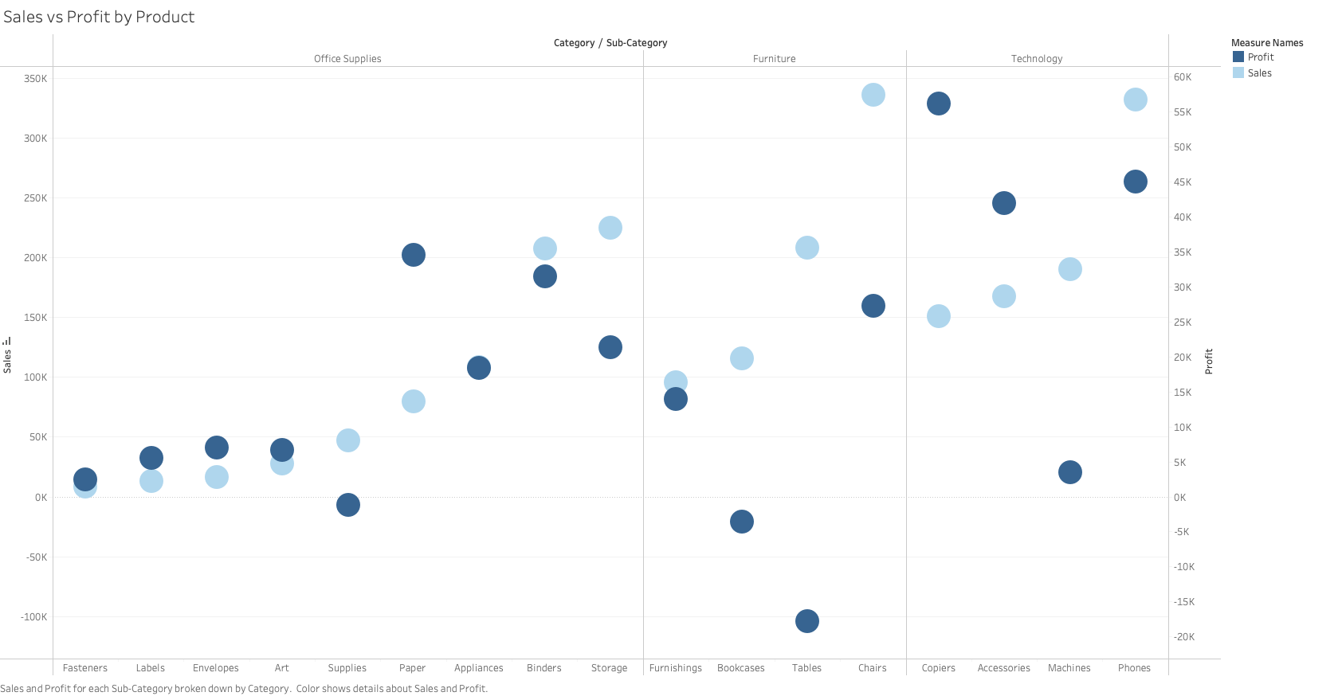
Sales vs Profit By Product

Slide 5
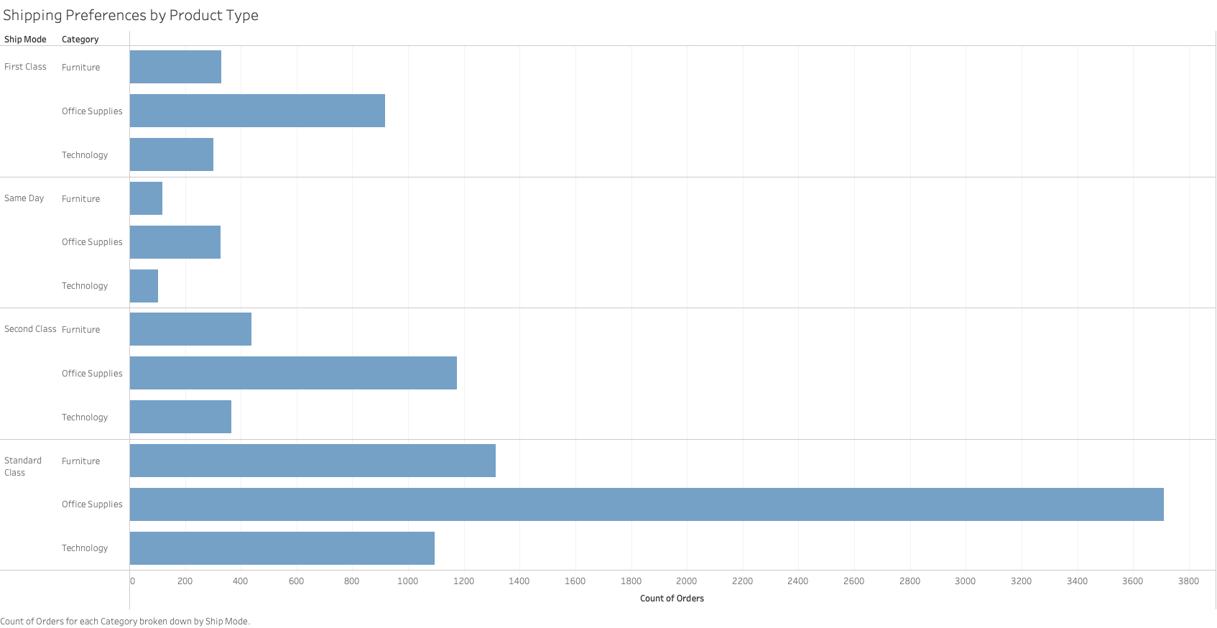
Shipping Preferences By Product Type

